Slide 1
Digital Portfolio
STUDENT NAME: G. EINSTEIN JOAN
REGISTER NO: 212402348 NMID: asunm1301212402348
DEPARTMENT: BCA
COLLEGE: COLLEGE/ UNIVERSITY: AGURCHAND MANMULL JAIN COLLEGE \ MADRAS UNIVERSITY

Slide 2
PROJECT TITLE
INTERACTIVE PORTFOLIO USING FRONT-END DEVELOPMENT

Slide 3


AGENDA
Problem Statement
Project Overview
End Users
Tools and Technologies
Portfolio design and Layout
Features and Functionality
Results and Screenshots
Conclusion
Github Link
3/21/2024 Annual Review

Slide 4

PROBLEM STATEMENT
In today’s competitive digital world, showcasing skills, projects, and achievements through a professional online presence is essential.
Traditional resumes often fail to highlight creativity, interactivity, and practical skills. Without a personal portfolio website, it becomes difficult for developers and designers to:
Effectively demonstrate their skills and projects in an engaging way.
Build a strong personal brand and professional visibility
Provide recruiters, clients, and peers with easy access to their work and contact details.
This project aims to solve the problem by creating a responsive, user-friendly, and interactive personal portfolio website that highlights technical skills, showcases projects, and makes networking seamless.

Slide 5

PROJECT OVERVIEW
This project is a personal portfolio website designed to showcase my skills, projects, and achievements in a professional and engaging manner.
It is built using HTML, CSS, and JavaScript with a fully responsive layout to ensure seamless access across devices.
The website includes:
Hero Section – Introduction with profile image.
About Section – Brief summary of background and goals.
Skills Section – Display of technical skills with icons.
Projects Section – Interactive project cards with preview modal.
Contact Section – Contact form and social media links.
Additional Features – Sticky navbar, mobile-friendly menu, back-to-top button, and smooth animations.
This portfolio serves as a digital identity, helping me connect with recruiters, peers, and clients while reflecting both creativity and technical expertise.

Slide 6

WHO ARE THE END USERS?
Students → to showcase academic projects, skills, and learning journey.
Freelancers → to attract clients by displaying completed work and services offered.
Job Seekers → to present skills, projects, and achievements to recruiters and employers.
Professionals → to build a strong digital presence, expand networks, and highlight career growth.

Slide 7

TOOLS AND TECHNIQUES
Tools Used:
HTML → for webpage structure
CSS → for styling and layout
JavaScript → for adding interactivity
VS Code → for writing code
GitHub → for hosting & sharing
Techniques Used:
Responsive Design → adjusts for mobile & desktop
Grid & Flexbox → clean and organized layouts
Event Handling → buttons, menus, image pop-ups
Transitions & Effects → smooth animations
Form Design → simple contact form for users

Slide 8
POTFOLIO DESIGN AND LAYOUT
Sections included:
Hero Section → Introduction & profile picture
Home / About Me → Short bio and career goals
Skills → Technical skills with icons
Projects → Showcase of work with previews
Contact → Contact form & social links
Footer → Copyright & credits
Responsive Layout (Mobile + Desktop View)

Slide 9

FEATURES AND FUNCTIONALITY
Navigation bar with smooth scrolling
Project showcase with images/details
Interactive elements (hover effects, animations)
Contact form with validation
Responsive design for all devices

Slide 10
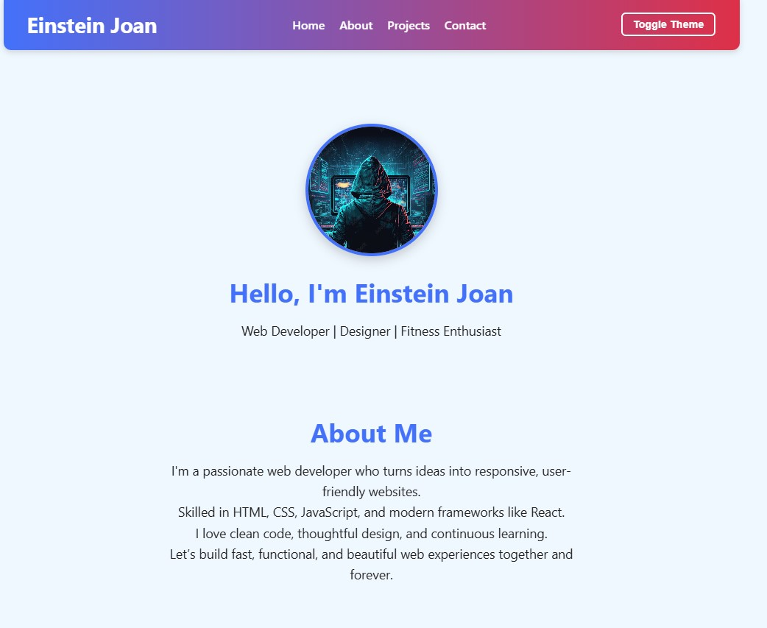

RESULTS AND SCREENSHOTS

Slide 11
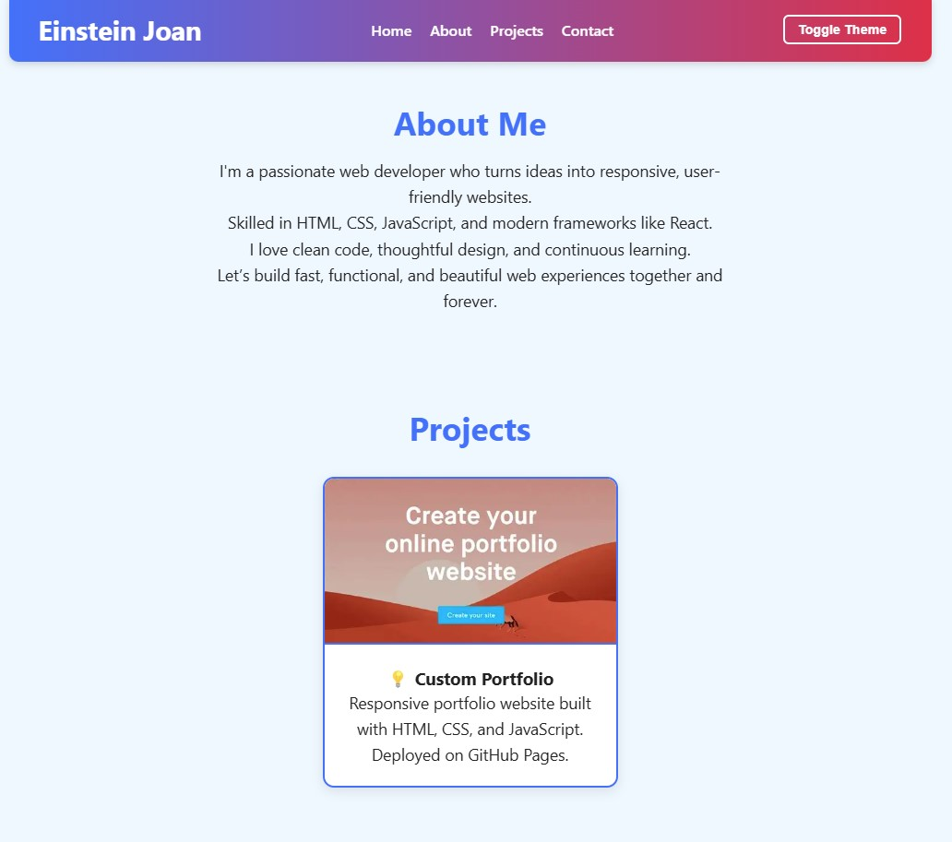
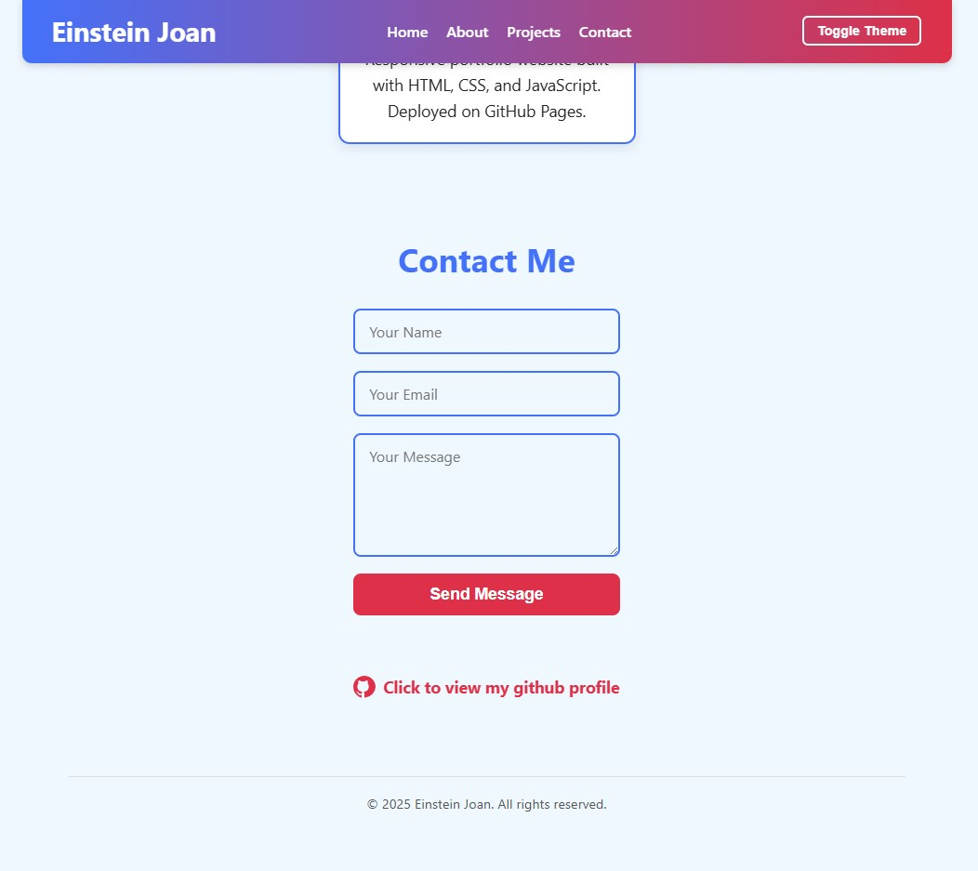

Slide 12
CONCLUSION
Promoting Knowledge Sharing: It provides accessible examples of web development and design, inspiring others to learn and create.Encouraging
Professional Growth: It supports career development, helping skilled professionals connect with opportunities and clients, boosting the economy.Fostering
Digital Literacy: By demonstrating clean, responsive, and user-friendly design, it encourages higher standards in online communication and usability.
Supporting Remote Collaboration: Such portfolios make it easier for people worldwide to find and collaborate with developers and designers, bridging geographical gaps.
Inspiring Creativity and Innovation: Highlighting projects and ideas sparks creativity and innovation in the tech community and beyond.
Overall, this portfolio exemplifies how individual digital presence can drive community growth, learning, and technological advancement.

